Slide 1

Calnexus Solutions
Proposes

Slide 2

Custom Hospital management Solution
For Marura Hospital

Slide 3
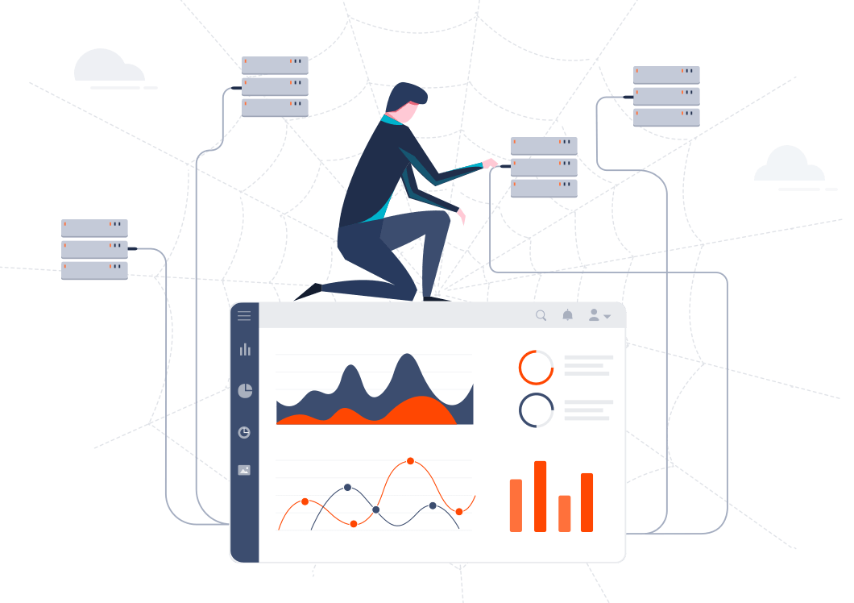
Why introduce a Custom Hospital Management system
Organizations are accumulating data at a faster pace than ever before. However, this data is only valuable when converted into information that can be easily digested by stakeholders. Sharing critical, easy-to-read pieces of information directly with stakeholders will provide valuable insights that will empower you to transform your business.
Creating a custom solution will help and ease the process of porting all the existing hospital records and train the new system to behave exactly like the existing system.
The new system will solve all the critical challenges faced from the existing system and add more functionalities, control and more improved security features

Slide 4

Out of the box features we will provide with the custom solution

Slide 5

Advanced Collaboration Among Departments
This feature will let departments view and review patient data with ease.
The collaboration features will revolve around real-time messaging Platform and easy file sharing features
Built-in support for comments makes collaboration incredibly easy and effective.

Slide 6

World-class infrastructure
The Custom Solution will be powered by Microsoft’s Azure platform. Microsoft Azure is powered by infrastructure spanning more than 100 highly secure facilities worldwide and linked by one of the largest networks on earth.

Slide 7
Access from any platform
Your users can view the software on any platform, including Windows®, Linux, macOS®, iOS®, Android™, and Chrome OS™. Bold BI is supported by any device, including tablets and phones.

Slide 8
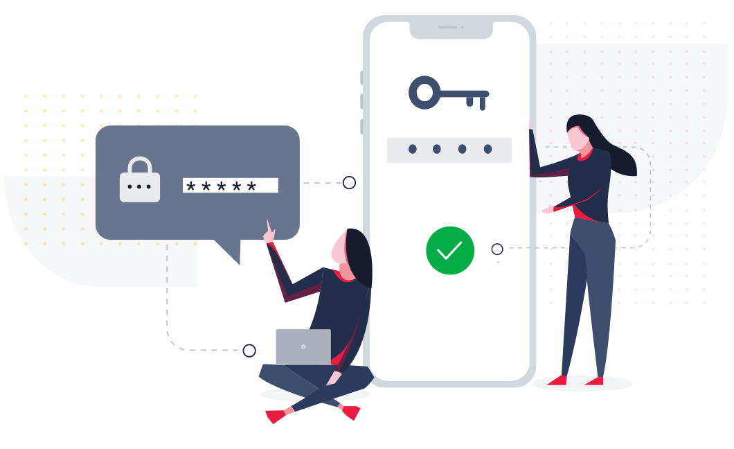
Multi-factor authentication
Multi-factor authentication is available when securing the system with providers that support MFA, such as Office 365.
The system will allow different access and authorization levels. It will be based on a role bases authorization where each user can only access the system based on their roles and access level.

Slide 9

Advanced Traffic Security
All traffic will be secured using Transport Layer Security protocol (TLS 1.2). You can rest assured that your data will be safe.

